Slide 1




OUTBACK ROBOTS
Build. Learn. Leap Ahead
Lesson 1 - Meet Blossom:
An Introduction to Social Robots
Notes:
Welcome, give you a brief overview of program, justify our choices, enable you to provide high quality feedback during the codesign session

Slide 2
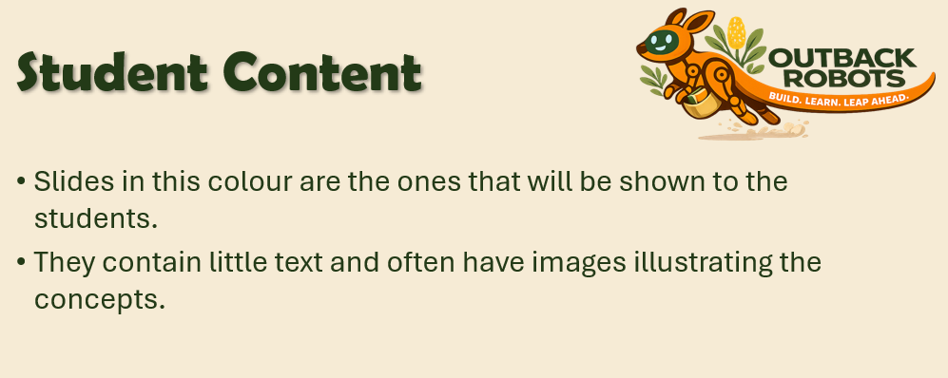
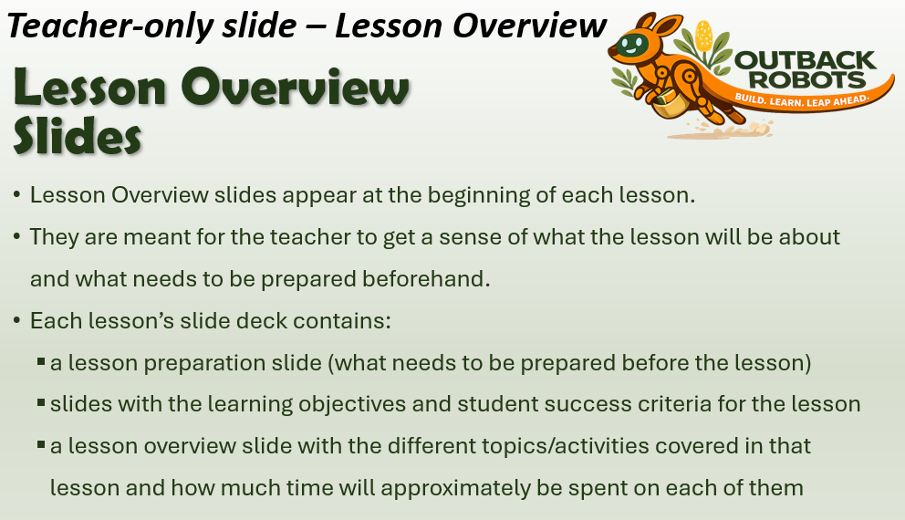
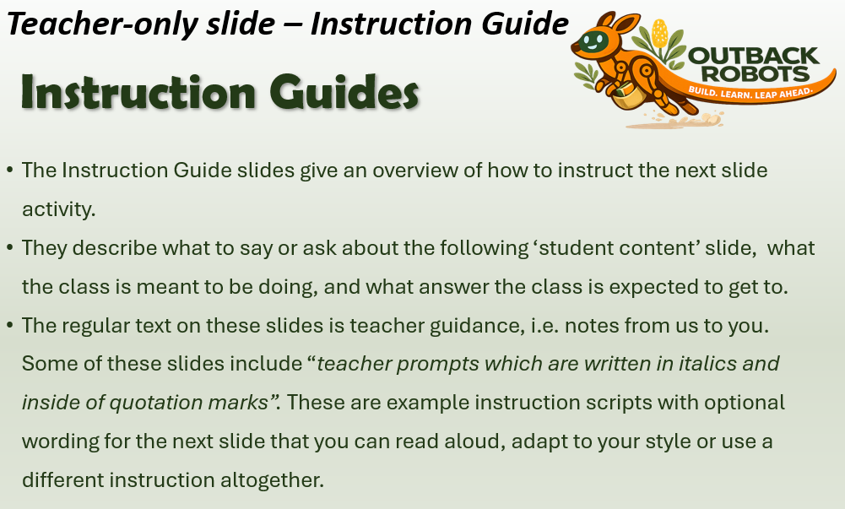
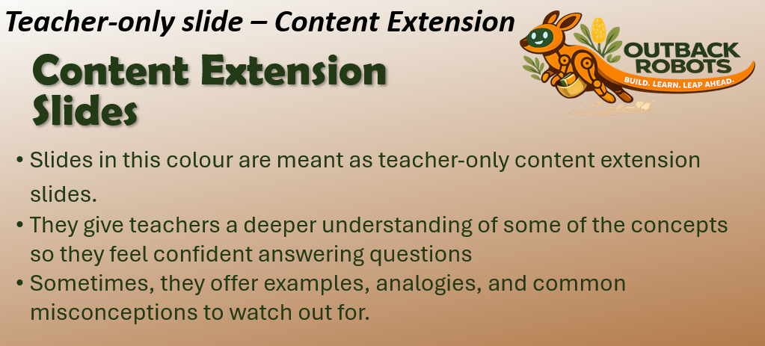
4 Types of Slides

Slide 3
Lesson Overview Slides
Lesson Overview slides appear at the beginning of each lesson.
They are meant for the teacher to get a sense of what the lesson will be about and what needs to be prepared beforehand.
Each lesson’s slide deck contains:
  a lesson preparation slide (what needs to be prepared before the lesson)
  slides with the learning objectives and student success criteria for the lesson
  a lesson overview slide with the different topics/activities covered in that lesson and how much time will approximately be spent on each of them

Slide 4
Student Content
Slides in this colour are the ones that will be shown to the students.
They contain little text and often have images illustrating the concepts.

Slide 5
Instruction Guides
The Instruction Guide slides give an overview of how to instruct the next slide activity.
They describe what to say or ask about the following ‘student content’ slide, what the class is meant to be doing, and what answer the class is expected to get to.
The regular text on these slides is teacher guidance, i.e. notes from us to you. Some of these slides include “teacher prompts which are written in italics and inside of quotation marks”.
  These are example instruction scripts with optional wording for the next slide that you can read aloud or put into your own words.
  They are meant as a support for teachers, who have not taught lessons about these contents before, to give them further guidance and offer reassurance.
  If you do not like the example scripts, feel free to adapt them or use your own phrasing altogether.

Slide 6
Content Extension Slides
Slides in this colour are meant as teacher-only content extension slides.
They give teachers a deeper understanding of some of the concepts so they feel confident answering questions
Sometimes, they offer examples, analogies, and common misconceptions to watch out for.

Slide 7
Lesson Preparation
1. Before you start:
Build your own Blossom to get familiar with the process and use it for demonstration purposes (‘Teacher’s Blossom’)
Contact the study team in advance in case you run into any issues
Familiarize yourself with the slides and activities in this lesson.
You can print off the teacher slides or add any notes/parts of the example scripts to the notes on the student slides. This way, you can see them when in presenter mode.
  Then hide the teacher slides, so they don’t get shown when you present.
We recommend to go through the slides in presenting mode, so that you also become familiar with the animations and order in which the different items appear.

Slide 8
Lesson Preparation
2. Classroom Setup
  Plan student groups for the hands-on activities throughout the program
  Our recommendation: 3 students per Blossom kit, select groups such that
    ability is roughly equally distributed between the groups, so groups progress at a similar pace, and
    conflict and distraction are minimized within the groups.
Materials needed: Blossom kits, pre-assembled Teacher’s Blossom, one student device (laptop or tablet) per group
3. Right before the lesson:
  connect to the Teacher’s Blossom’s WiFi, wait 5 minutes, then open the interface at https://192.168.90.1:8080

Slide 9
Lesson 1 - Overview
1. Introduce Blossom - 5 min
2. Outback Robots Program & Study Overview - 5 min
3. Robots - 20 min
  3.1 Where can robots be found?
  3.2 Social Robots
  3.3 What is (not) a robot?
4. Parts of a robot - 45 min
  4.1 What parts does every robot need?
  4.2 Investigating the pieces of Blossom and their functions
  4.3 Making a motor move
5. Optional extension: When should robots (not) be used? - 15 min
6. Questionnaire - 5 min
7. Lesson summary - 5 min
  Total: XX min (+ 15 min extension)

Slide 10
Lesson 1 –
Learning objectives
After this lesson, students will be able to:
explain where robots appear in everyday life,
understand that there are different types and categories of robots,
distinguish robots from other machines,
identify the essential components of a robot (sensors, controller, motors, wires) and their specific functions,
discuss helpful and harmful uses of robots across different settings.

Slide 11
Lesson 1 -
Student success criteria
I can explain what the key features of robots are and what makes them different from other machines.
I can name 3 types of robots and what they are being used for.
I can identify the main components that robots require to function.
I can describe what the functions of the motors, computer and wires inside a robot are, and recognize them among the pieces of Blossom.
I can discuss when robots should or shouldn’t be used by giving 2-3 example scenarios and give reasons on why using robots would be helpful or harmful in this context.

Slide 12
Introduction Suggestion
Announce that you brought a special guest for today’s lesson.
Showcase the assembled teacher’s Blossom robot, make it move using the interface.

Slide 13
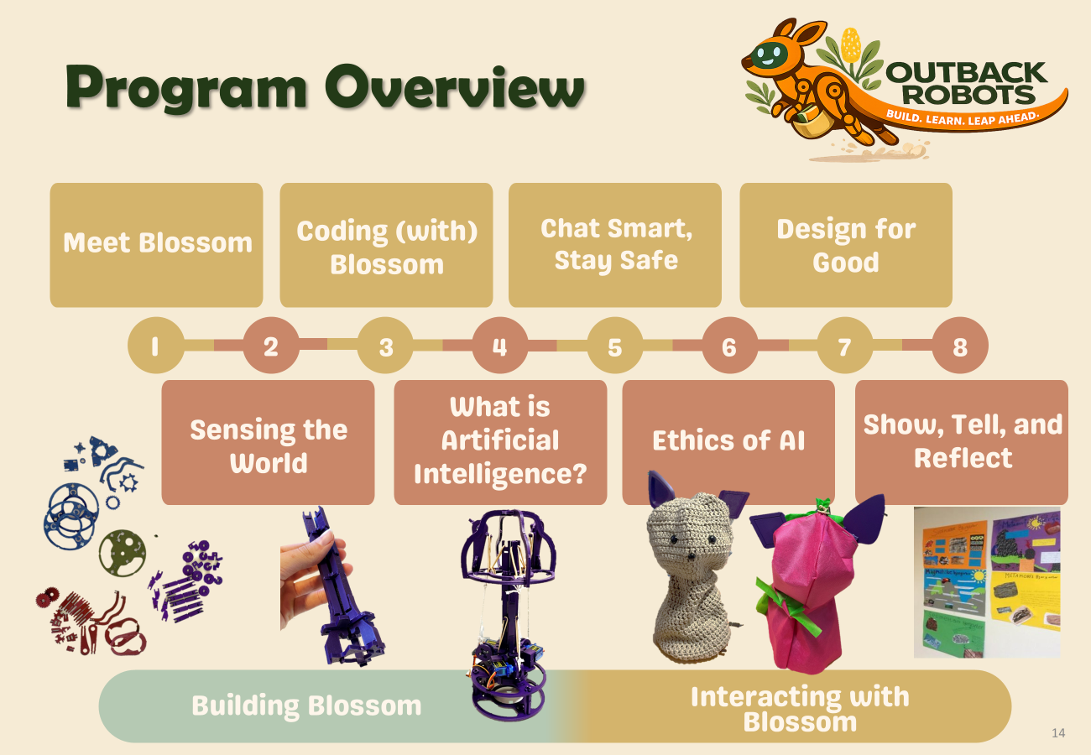
Program Overview
What is Outback Robots?
Use the Program Overview slide to explain that over the next 8 lessons, your class gets the chance to take part in a project by Flinders University through which students will learn about robots and AI. They will work with a robot called Blossom and do hands-on activities in teams. This also includes building their own robot.
Why are we doing it?
Robots and AI are increasingly becoming a part of everyday life. This program helps you understand how they work and how to make good choices while using them.
What the “study” means?
The scientists who created the lessons want to know what they are like for students and teachers so they can improve them. To help them, you will all fill out a few questions at the end of every lesson.

Slide 14
Program Overview
Artificial Intelligence
Understanding AI
Using AI
Evaluating AI
Coding (with) Blossom
Ethics of AI: Bias, Fairness and Impact
Chat Smart, Stay Safe: Generative AI, LLMs and Digital Safety
Meet Blossom: An Introduction to Social Robots
1
2
3
4
5
6
7
8
Sensing the World: From Signals to Data
Design for Good: AI, Society and Sustainability
Show, Tell, and Reflect: Presenting Your Robot
What is AI? Algorithms and Predictions
Building Blossom
Interacting with Blossom
Social Robotics
Notes:
Blossom is a social robot

Slide 15
Program Overview
Artificial Intelligence
Understanding AI
Using AI
Evaluating AI
Coding (with) Blossom
Ethics of AI: Bias, Fairness and Impact
Chat Smart, Stay Safe: Generative AI, LLMs and Digital Safety
Meet Blossom: An Introduction to Social Robots
1
2
3
4
5
6
7
8
Sensing the World: From Signals to Data
Design for Good: AI, Society and Sustainability
Show, Tell, and Reflect: Presenting Your Robot
What is AI? Algorithms and Predictions
Building Blossom
Interacting with Blossom
Social Robotics

Slide 16
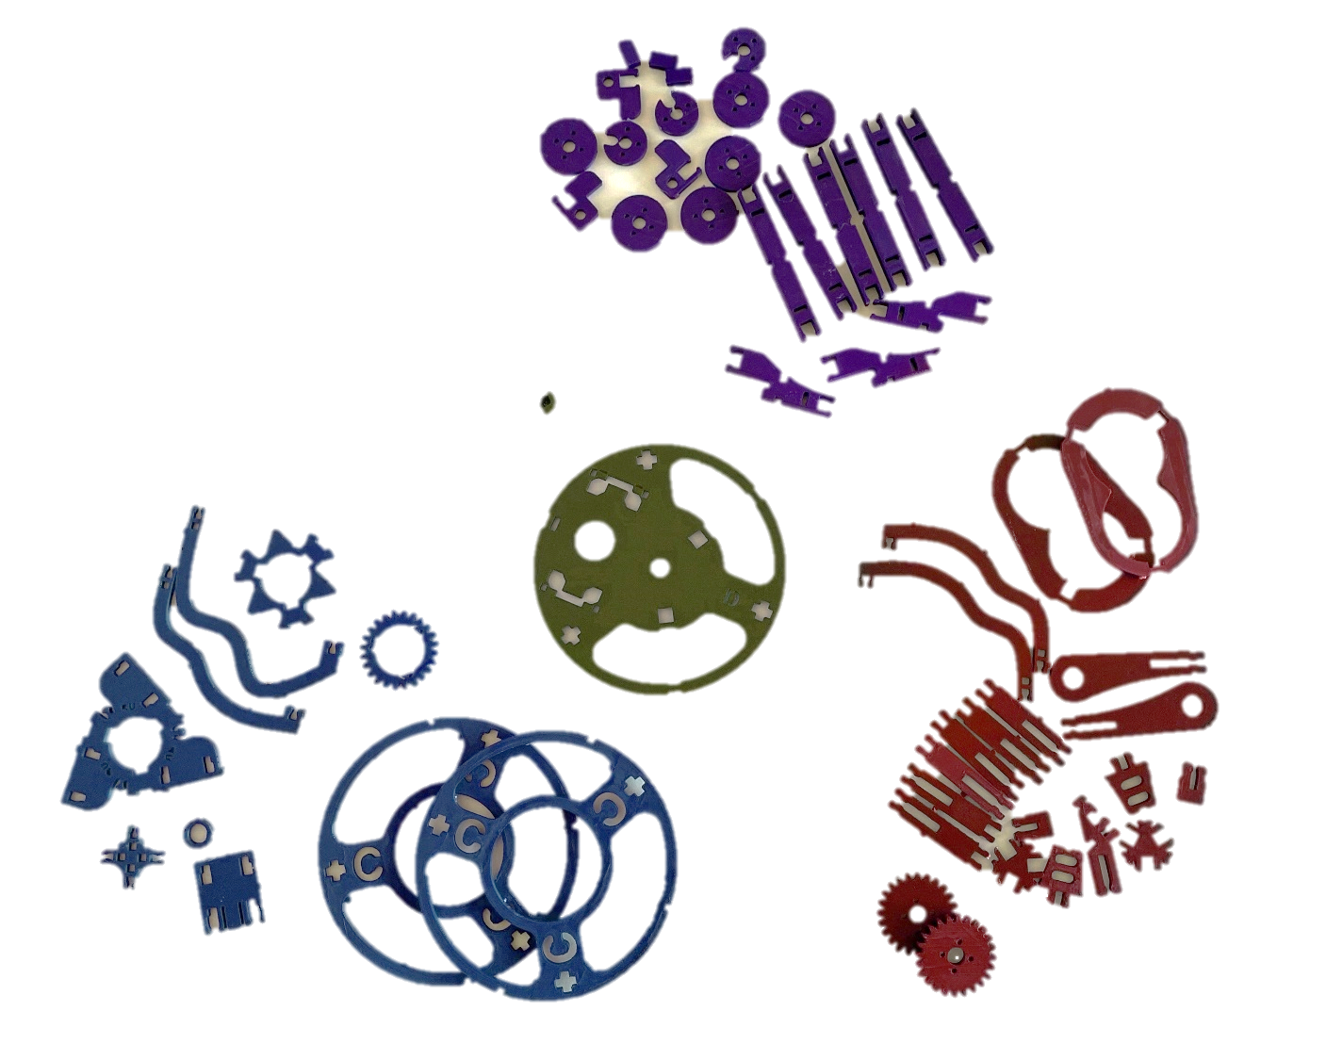
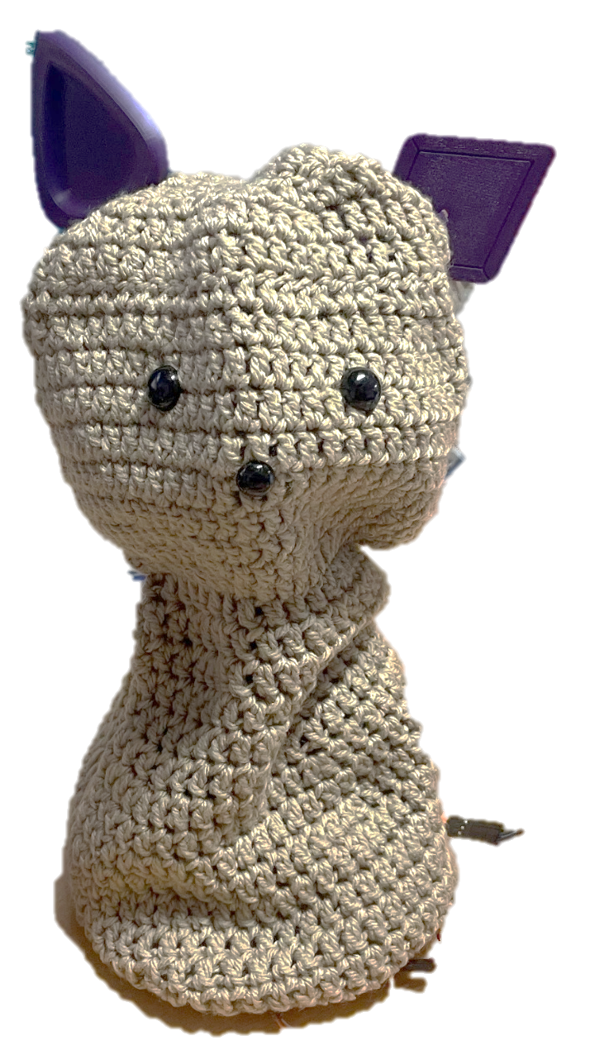
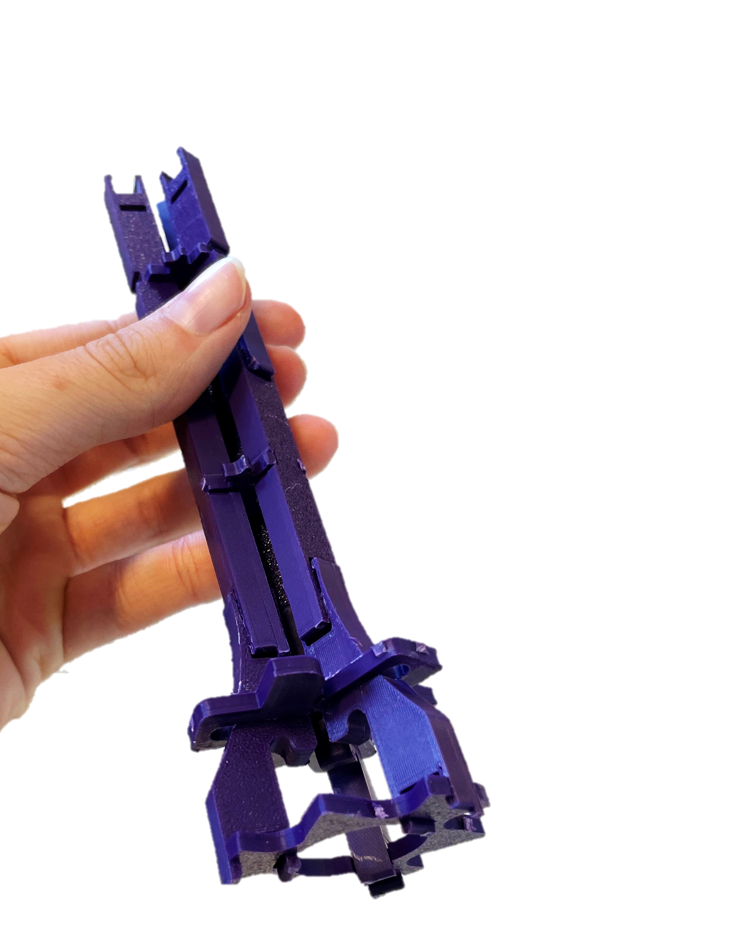
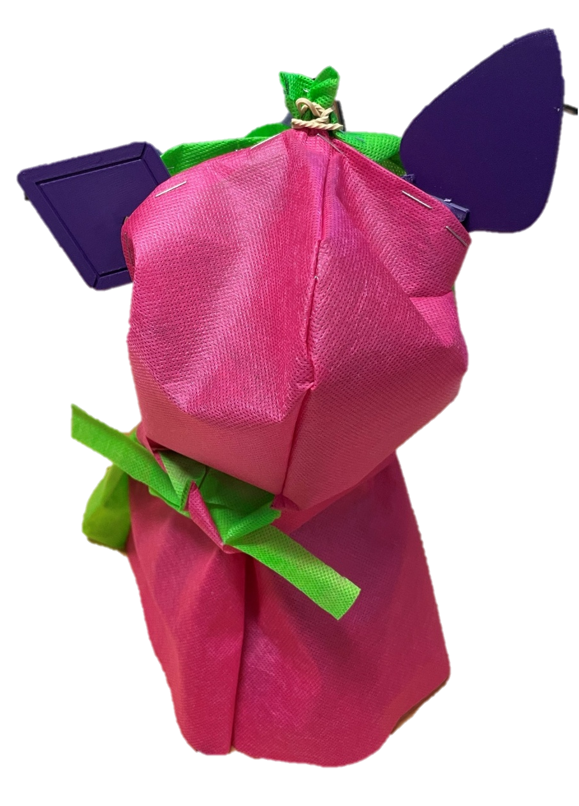
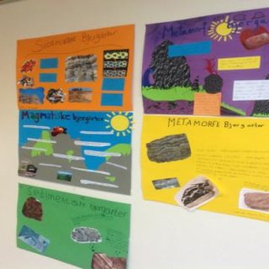
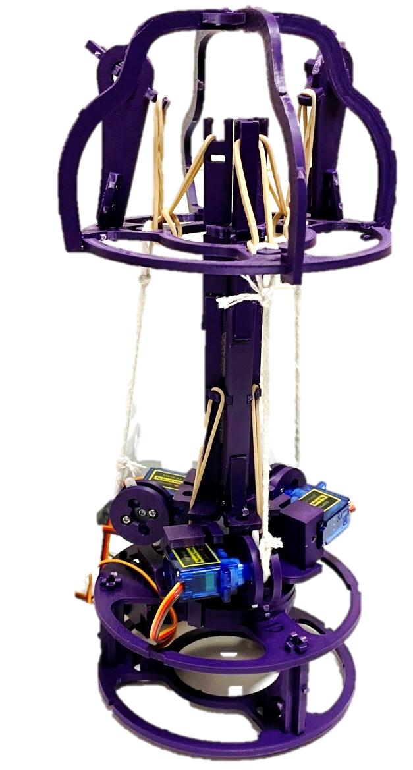
Program Overview
Meet Blossom
Coding (with) Blossom
Chat Smart, Stay Safe
Design for Good
1
2
3
4
5
6
7
8
What is Artificial Intelligence?
Sensing the World
Show, Tell, and Reflect
Ethics of AI
Building Blossom
Interacting with Blossom
Notes:
Blossom is a social robot

Slide 17


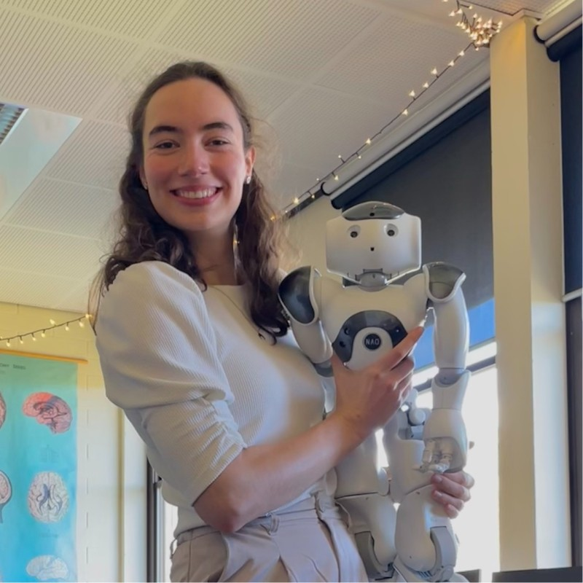
The Research Team
A/Prof Dr. Nathan Caruana
Ben Kelly
Sophia Jaeger
Project Lead
Nathan.Caruana@flinders.edu.au
Technical Support
ben.kelly@flinders.edu.au
Curriculum and Material Development
Ben will be available remotely to provide support during the lessons for both you and students.
You can use the next slide to introduce him to the class.

Slide 18
Online support –
Ben Kelly
Ben Kelly
Ben will be available during the lessons to answer any questions and support the robot building.

Slide 19
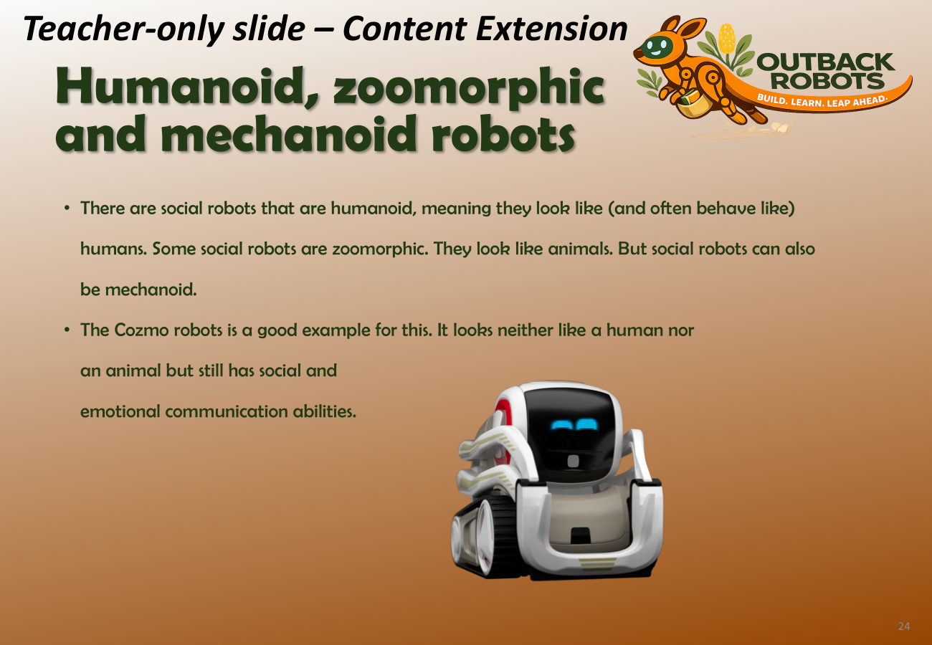
Robots – Hook & Brainstorm
Example Script:
  “Where have you already seen robots being used? What did they look like? What other types of robots do you think exist?”
  Instruction Note:
    Students might already have strong robot images (often humanoid robots from movies)
      if this is the case, you can use this result as the basis for further discussion later in this lesson
      there is also a teacher extension slide about
      humanoid robots later in this slide deck (see
      screenshot on the right)

Slide 20
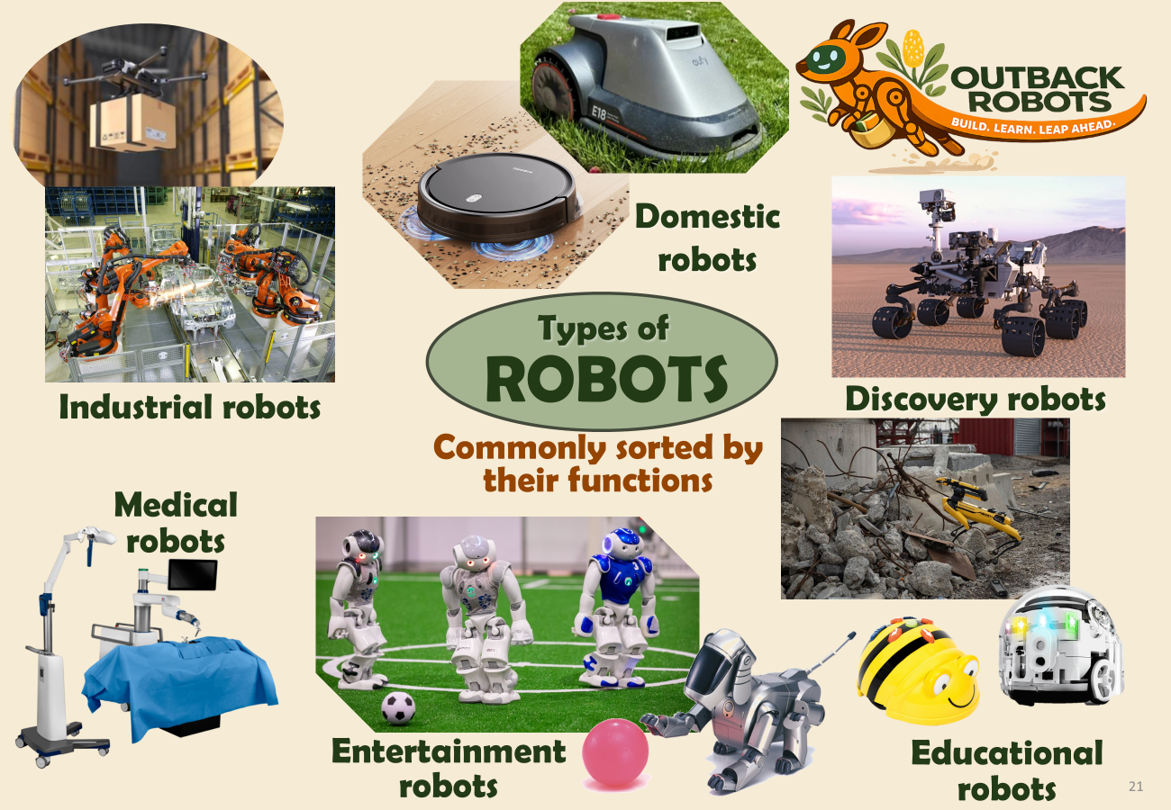
Robot Types
A key learning point in this lesson is that the definition and distinguishing criteria of ‘robots’ is fluid (because technology is always changing) and sometimes ambiguous
Robots can be categorized based on their applications/functions (see “Types of Robots” slide
below), their degree of movement (stationary vs mobile), or their autonomy (f.i. vacuum robot has lower autonomy, while a robot assistant has more).
The types of robots introduced in this lesson are categorized by function. This is a common way to sort robots into groups.

Slide 21
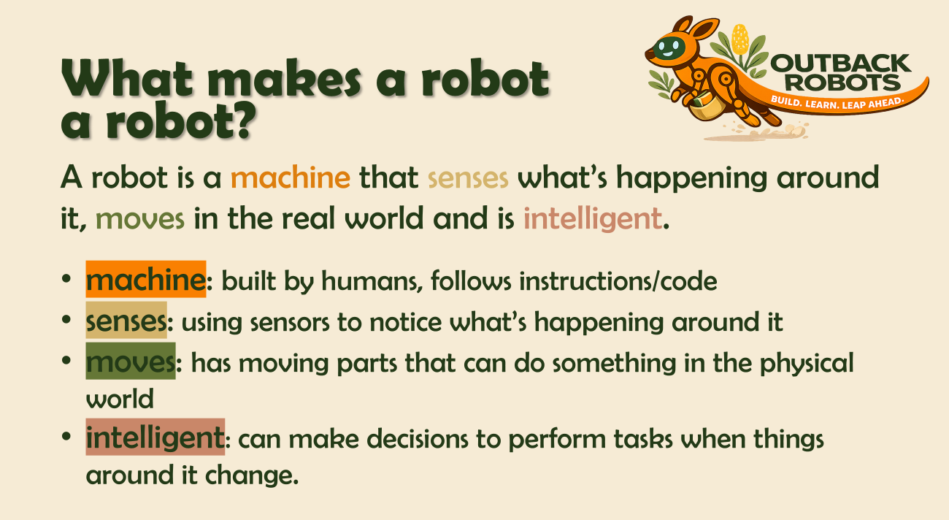
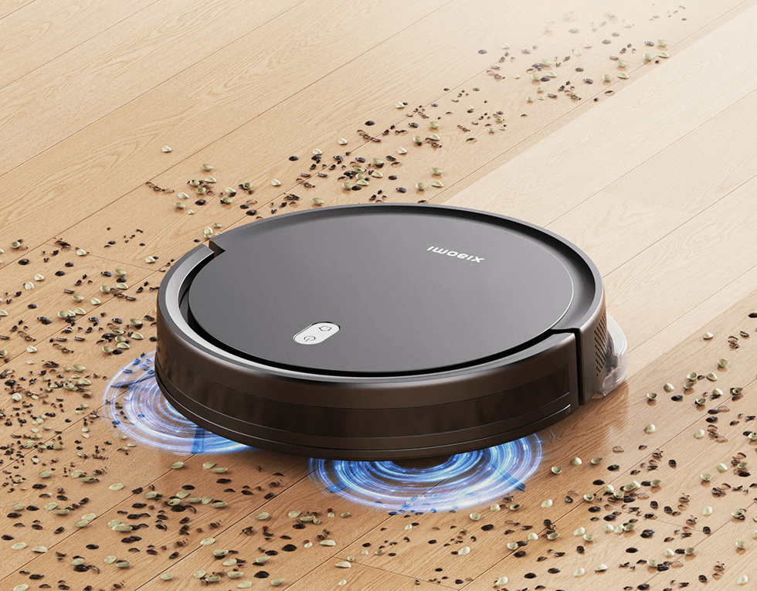
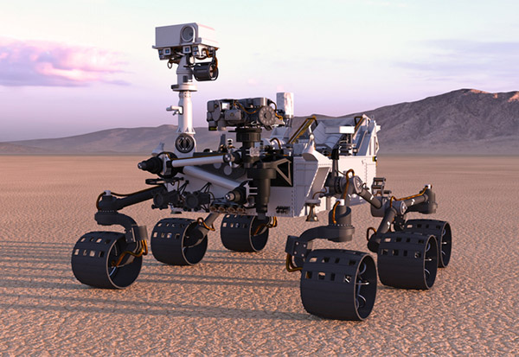
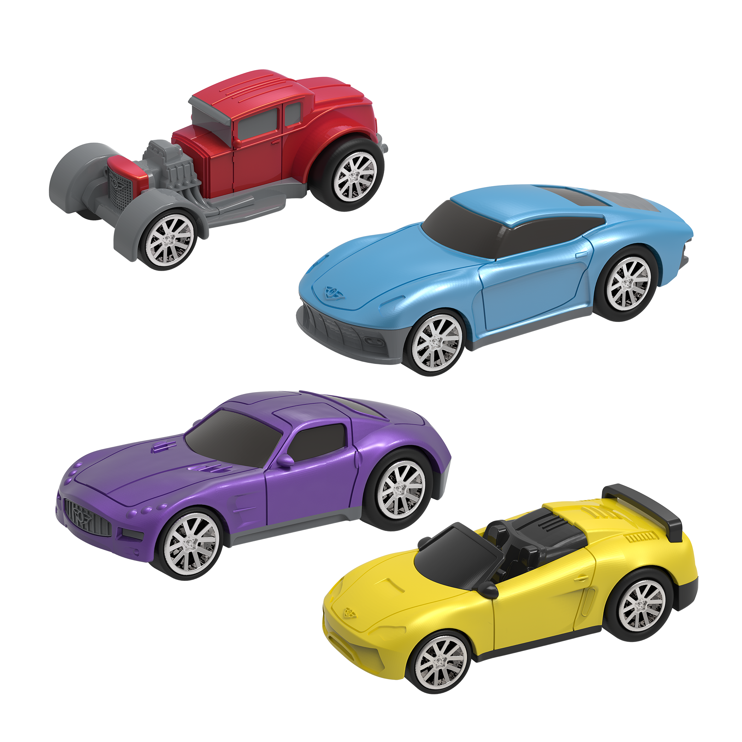
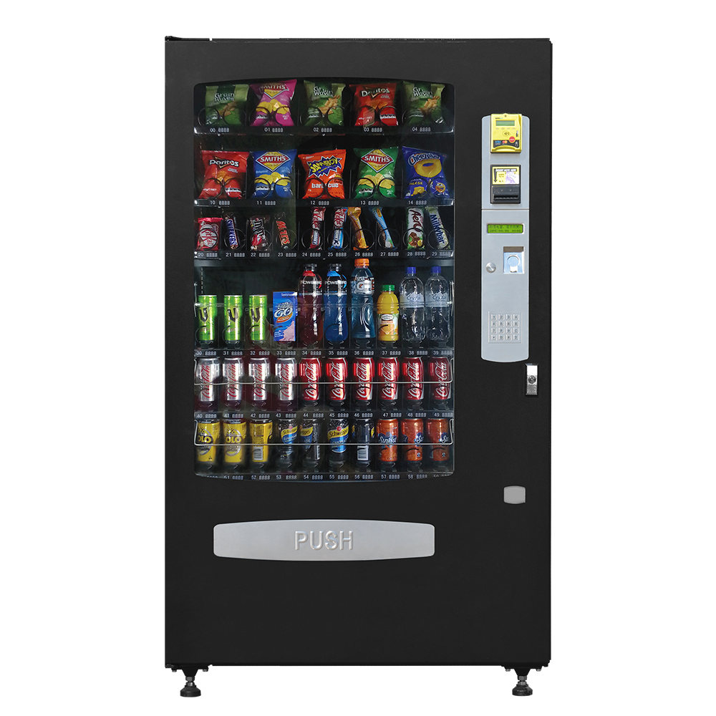
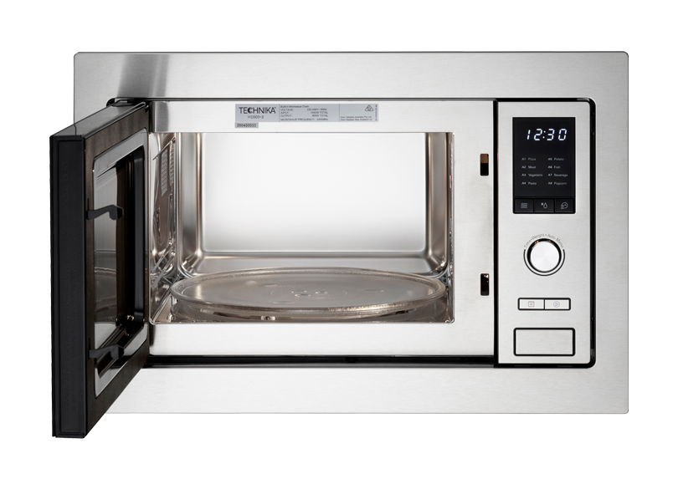
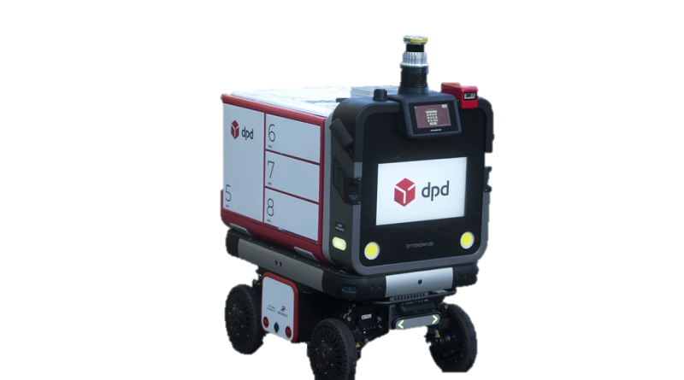
Autonomy
You can extend this lesson or discussion by introducing students to the concept of robot ‘autonomy’.
Autonomy = How much a machine can do by itself without a human controlling every step (i.e., how much help a machine needs from a human)
Can extend on this point following the discussion of robot “Intelligence” on the “What makes a robot” slide
no autonomy
low autonomy
medium autonomy
high autonomy
Toy car
Microwave, Vending Machine
performs the same action every time a button is pushed
Robot vacuum
can handle slightly changing environments, avoids furniture and returns to charger
Space rover, Delivery robot
is able to deal with changing environments, navigates, avoids obstacles, plans routes
moves only when it is pushed
Autonomy comes on a spectrum/range

Slide 22
Robot Types
Example Script:
  “Robots come in many different shapes and are used across a range of applications.”
Instruction Note:
  Present the different robots on the next slide and what they are for:
    industrial: perform repetitive manufacturing tasks (e.g., assembly in factory, warehouse drone)
    medical: e.g., robotic tools (e.g., surgical arm); social robots for lifting patients from beds
    entertainment: for fun and playing games (e.g., robot football tournaments, robot pet
    education: in schools to teach students (e.g. about coding)
    discovery: search and rescue, space missions
    domestic: help with chores around the house (e.g. vacuum cleaner, lawn mower)
  On the next slide, the images of robots appear by category (with animations).

Slide 23
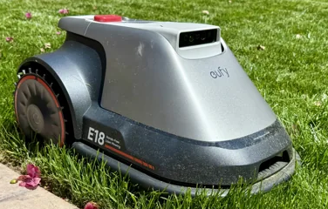
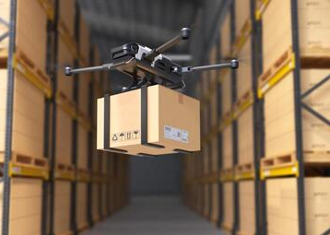
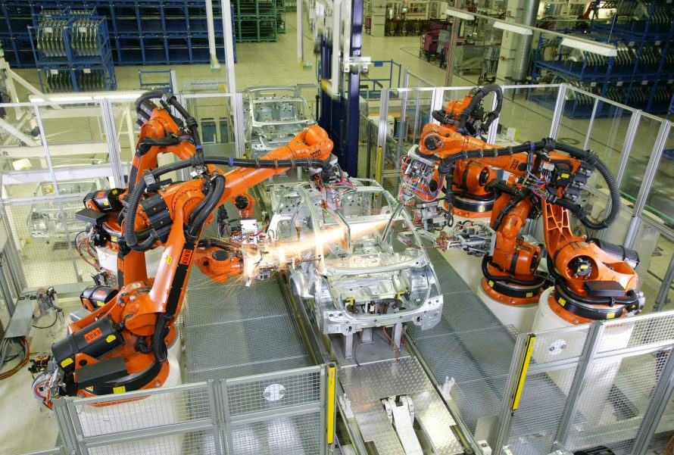
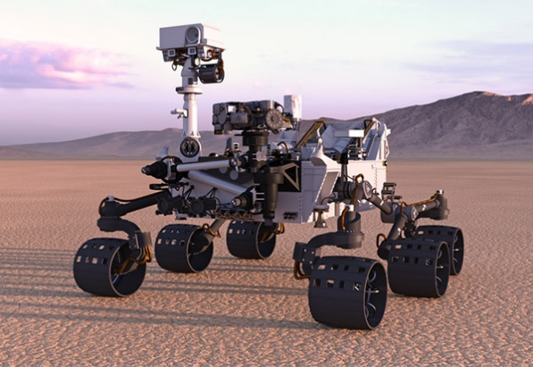
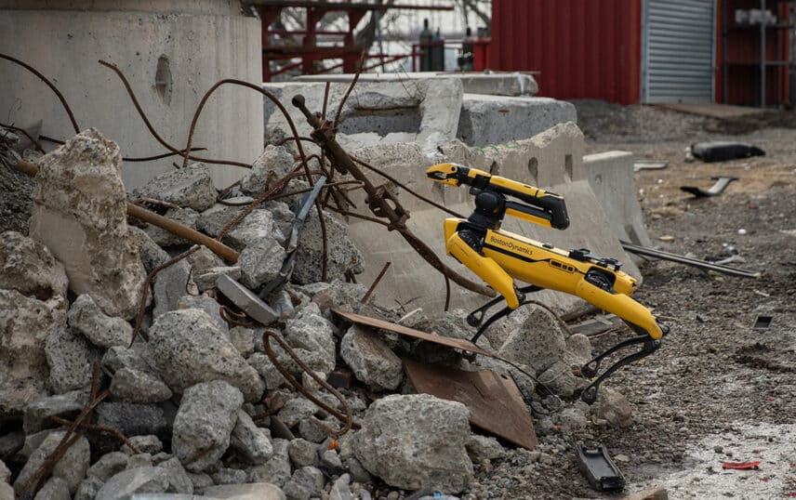
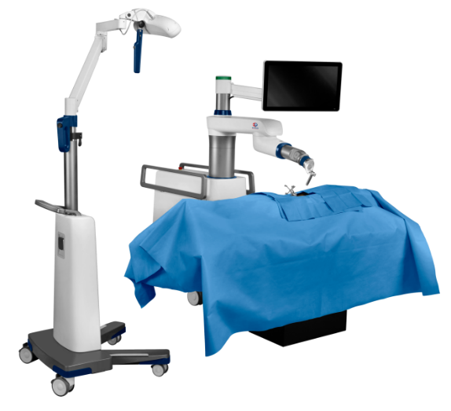
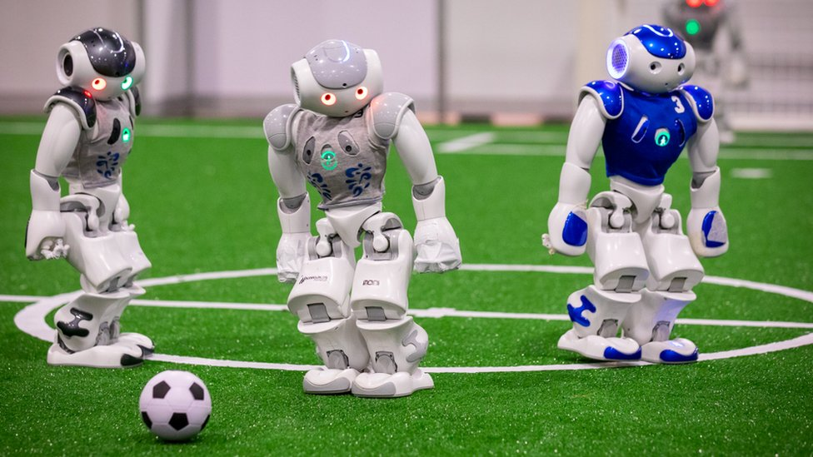
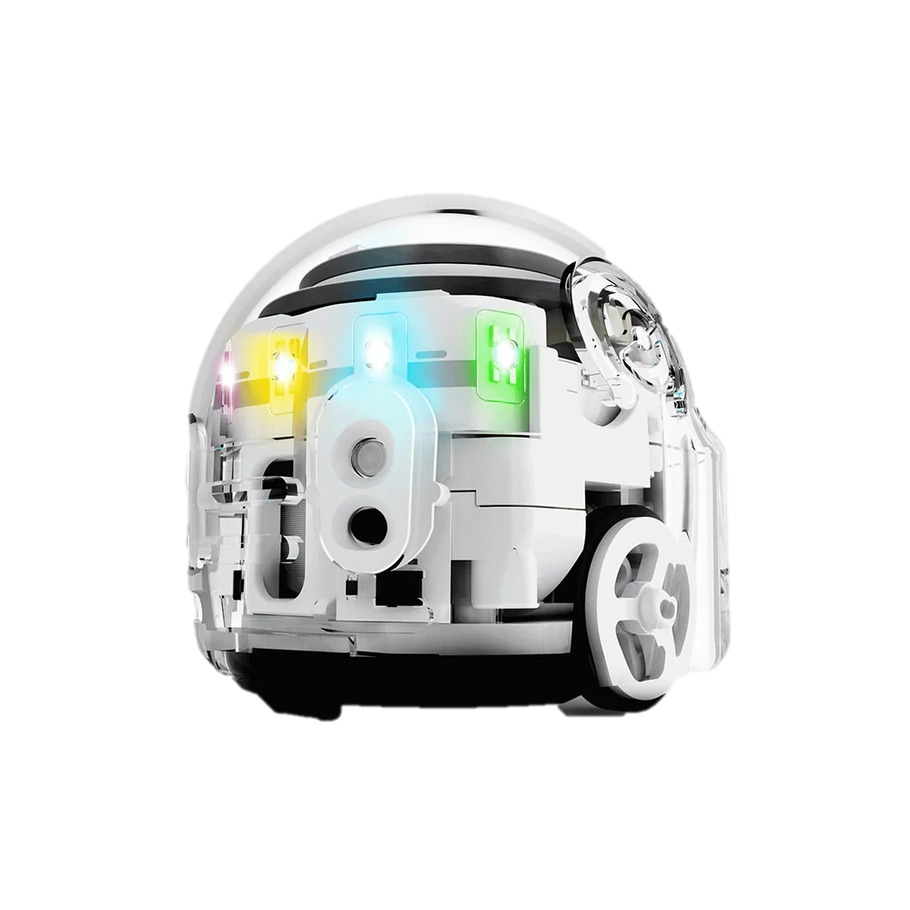
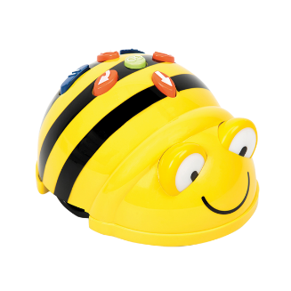
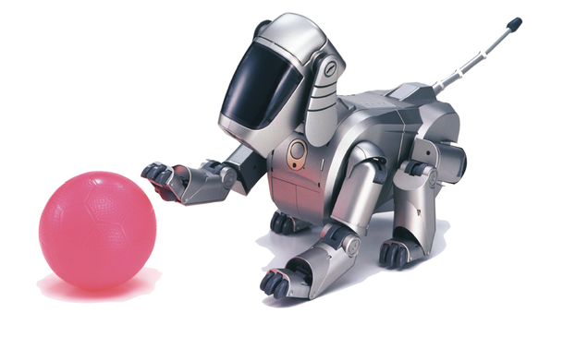
Domestic robots
Types of
ROBOTS
Industrial robots
Discovery robots
Commonly sorted by their functions
Medical robots
Entertainment robots
Educational robots
Notes:
BMW: https://themanufacturer-cdn-1.s3.eu-west-2.amazonaws.com/wp-content/uploads/2013/10/14115325/BD_spotwelding_S0568_054-1024x713.jpg
Drone: https://static.vecteezy.com/system/resources/thumbnails/006/024/471/small/delivery-drone-in-warehouse-photo.jpg
Medical: https://www.sportssurgeryclinic.com/wp-content/uploads/2025/01/EXCL_1609_TECH_FINALCONSTRUCT_EXCELSIUS_GPS_US_Robotics_System_FINALCONSTRUCT_OR_Setup-660x602.png.webp
Dog: https://d1fwgdbfuvd4ew.cloudfront.net/wp-content/uploads/sites/2/2022/11/03_1-thumb-765xauto-295.jpg
Football: https://c.files.bbci.co.uk/5CA5/production/_120671732_rcthu-64lr.jpg
Search and rescue: https://bostondynamics.com/wp-content/uploads/2023/11/spot-rubble-1024x538.jpg
Space: https://www.robotics247.com/images/article/GettyImages-1006754478_copy.jpg

Slide 24
Social Robots
Example Script:
  “Another type of robots are social robots.
    These are robots that can have social and emotional communication abilities.
    They can often talk, gesture or express emotions. This can be done through movement (like in Blossom), facial features (many robots on the next slide) or speech.
  Social robots are used for various applications and in different settings such as in education, healthcare, as assistant robots, or in customer service.”

Slide 25
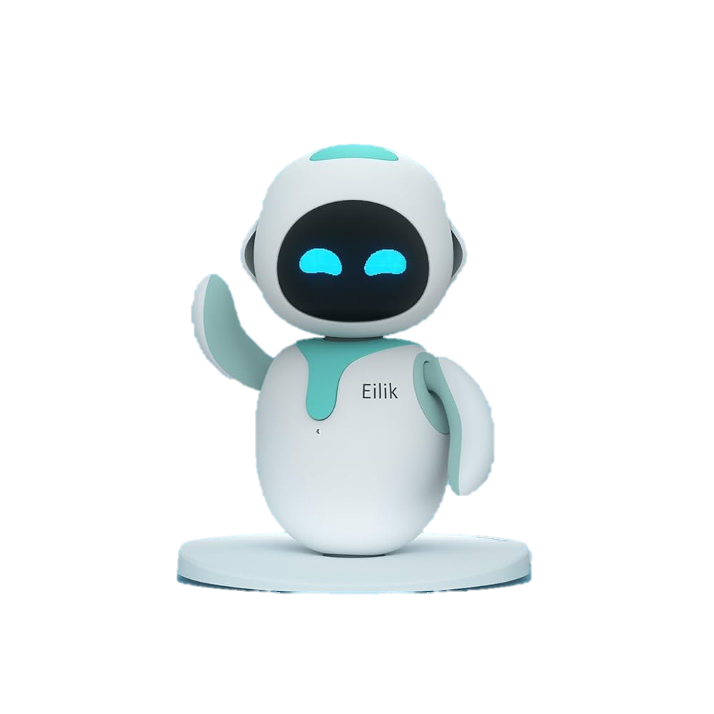
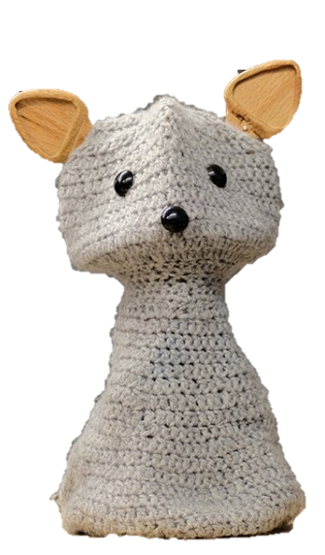
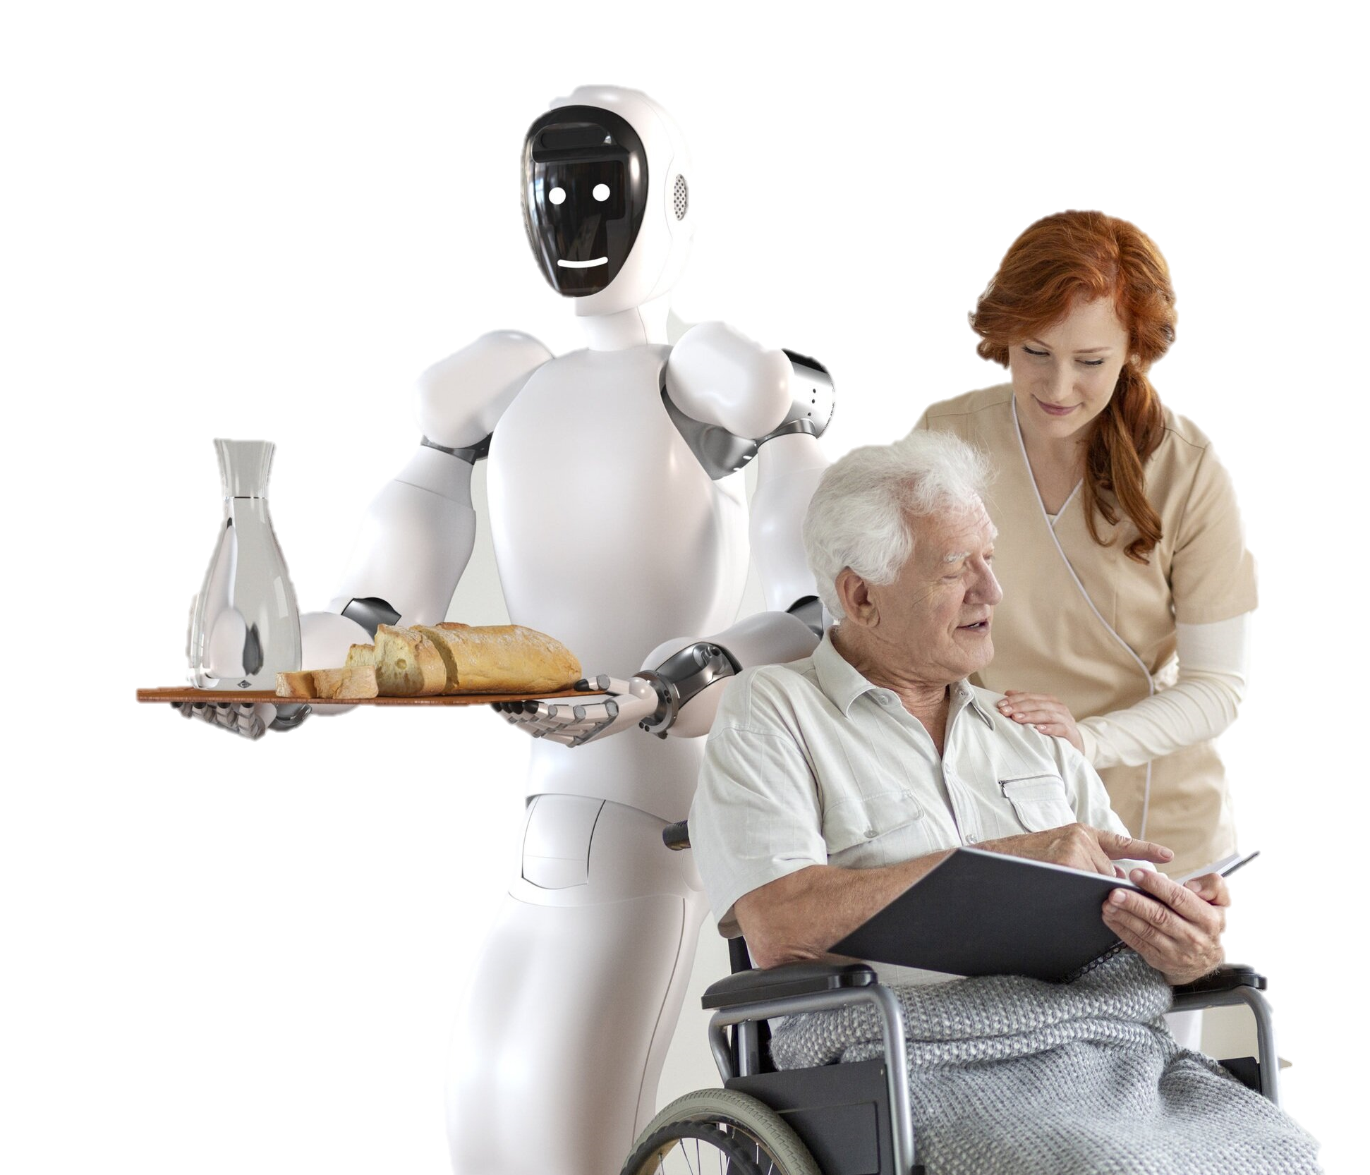
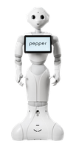
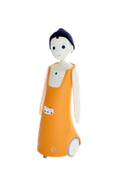
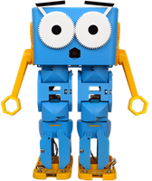
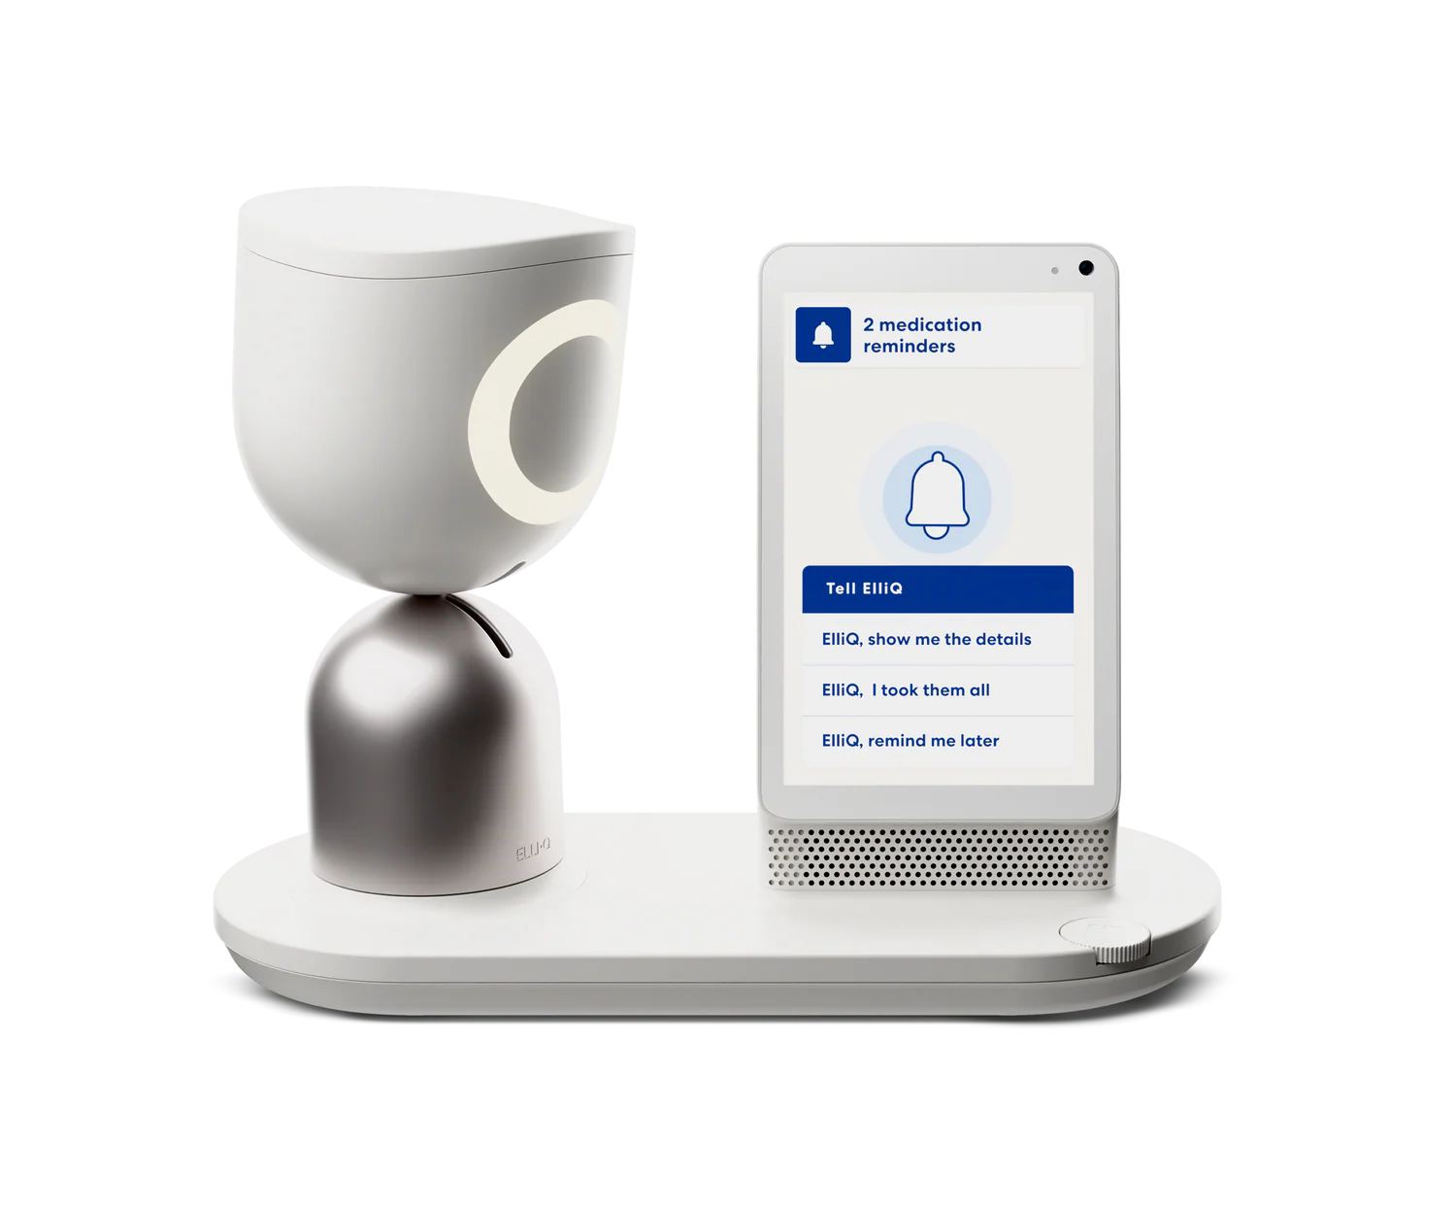
Social Robots
Robots that can have social and emotional communication
abilities (e.g., talk, gesture, show emotion)
Education
Healthcare
Assistant
Customer service
These robots can sometimes look human-like (e.g., have faces) but this is not a requirement for social robots.
Notes:
Assistant: https://m.media-amazon.com/images/I/51haNGCF4BL._AC_UF1000,1000_QL80_.jpg
Bee bot: https://www.terrapinlogo.com/media/.renditions/wysiwyg/beebot_1_clean_web_600x600.png

Slide 26
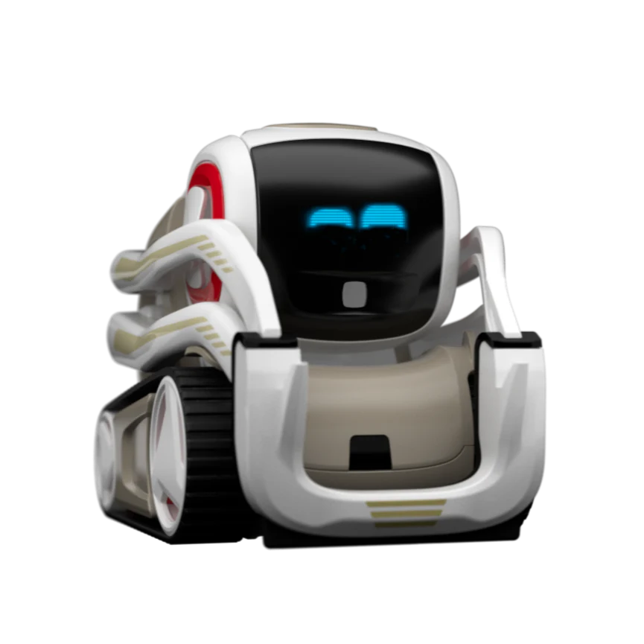
Humanoid, zoomorphic and mechanoid robots
There are social robots that are humanoid, meaning they look like (and often behave like) humans. Some social robots are zoomorphic. They look like animals. But social robots can also be mechanoid.
The Cozmo robots is a good example for this. It looks neither like a human nor
an animal but still has social and
emotional communication abilities.
Cozmo robot

Slide 27
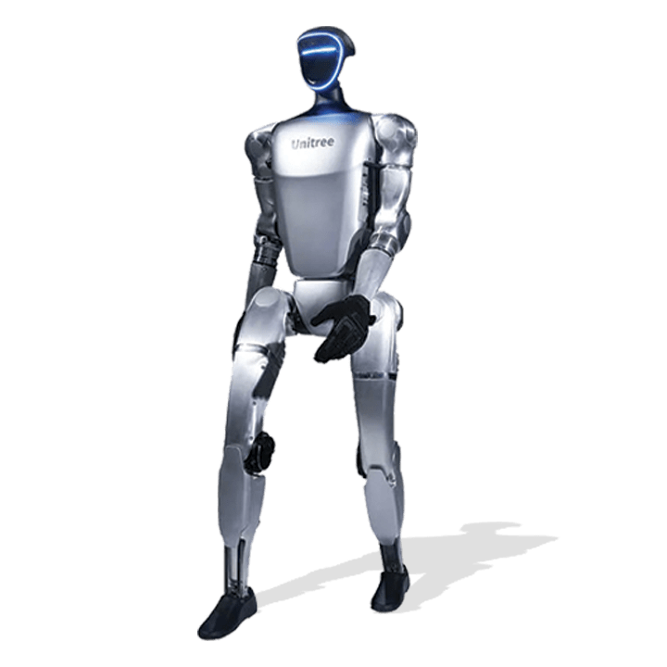
Humanoid Robots
Introduce the concept of humanoid robots
  Social Robots can be humanoid (robots that look like humans, often mimicking human movement or behaviour)
Use the previous slide about social robots and have students identify which of the depicted robots are humanoid and what features they share with humans.
  “The extent to which a robot is humanoid varies. Some of the robots slightly resemble human features (e.g. the Marty robot), while others look and behave a lot more human-like.”
vs
Marty robot
Humanoid robot

Slide 28
What do all robots have in common?
Instruction Note:
Still using the previous slide with the different types of robots, let students brainstorm what all the robots have in common and what makes them different from other machines (like a microwave or a smartphone).
Then go to the next slide: What makes a robot a robot?
  Introduce the rule (robot is a machine that senses, moves in the real world, and is intelligent)
  Then say:
  “It can be tricky to decide when a machine can be seen as intelligent. It does not equal “thinking like a human”. Rather, it means the robot can use sensor information and human-written code (instructions) to choose a suitable action.
  This decision-making can be autonomous (can be done on its own without a human controlling every step), or remote-controlled (a human decides each action, the robot still acts but has little or no autonomy).”

Slide 29
What makes a robot a robot?
A robot is a machine that senses what’s happening around it, moves in the real world and is intelligent.
machine: built by humans, follows instructions/code
senses: using sensors to notice what’s happening around it
moves: has moving parts that can do something in the physical world
intelligent: can make decisions to perform tasks when things around it change.

Slide 30
Is it a Robot?
  Instruction Notes:
  Discuss with the students for the different images if each of them is considered a robot. Why (not)? (possible answers & considerations on the next slide)
  Then explain:
    “It’s not always easy to decide, and there is ambiguity on what a robot is. There are some machines that are borderline, meaning some people consider them a robot while some don’t. It’s often a question of whether they can be seen as having enough intelligence or autonomy.
    The definition of what robots are is likely to keep changing as robots and AI technologies become more advanced.”

Slide 31
Is it a robot?
Vending machine can be considered a (very simple type of) robot
✓ machine
✓ moving parts
✓ notices/sensor
yes buttons (very simple type of sensor)
? slightly intelligent, low autonomy
moves to correct item on press of a button
Virtual assistant (not a robot)
✓ machine
X moving parts
cannot move and perform any actions in the physical/real world
✓ notices/sensor (microphone)
✓ intelligent, high autonomy
interacts socially (speaks, answers questions)
Printer can be considered a (very simple type of) robot
✓ machine
✓ moving parts
✓ notices/sensor
detects when low on ink, when paper jams, when human presses buttons
? slightly intelligent, low autonomy
performs an action only when initiated by a human, but stops when it detects an error
Vacuum cleaner (robot)
✓ machine
✓ moving parts
✓ notices/sensor
detect objects & walls, some even detect dirt
✓ intelligent, medium autonomy
cleans by itself and changes direction with obstacles, but still considered only partly autonomous since limited decision-making

Slide 32
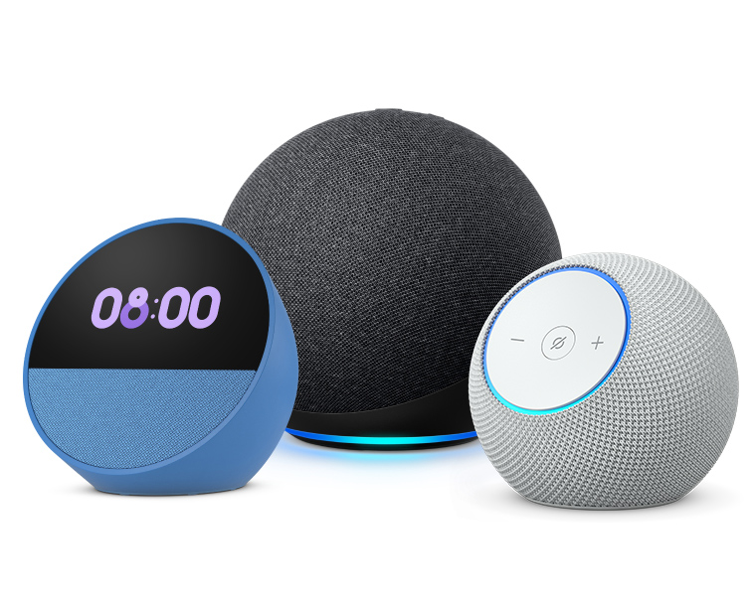

Is it a robot?
A robot is a machine that notices, thinks, and moves.
vacuum cleaner
virtual assistant (Alexa, Echo & Co)
vending machine
printer
Notes:
Vending machine: https://www.svavending.com.au/wp-content/uploads/2023/02/VCM-5000-2.png
printer: https://cdn.theschoollocker.com.au/media/catalog/product/cache/1/image/9df78eab33525d08d6e5fb8d27136e95/2/5/25_230_7.jpg
Assistant: https://m.media-amazon.com/images/G/02/kindle/journeys/sSUAUgtS9RUMKYEg/YTc3Zjc4YWEt._CB778449758_.jpg

Slide 33
Working with Blossom
Instruction Note:
Before handing out the kits, discuss with the students what them working with their Blossom and its parts should look like.
You can do this using your school’s values (e.g. how to handle pieces responsibly, be respectful towards others, be safe when building, …). We have listed some options on what to talk about on the next slide.
Further, we recommend playing the Blossom instruction video BEFORE handing out Blossom kits.
Remind students which parts of the kit are to be used in this lesson.
Instruct students not to unpack entire kit, which is organised to help them follow in subsequent lessons.
We recommend to designate a student in each group responsible for kit.
Then explain the robot kits to students.

Slide 34
Working with Blossom
Our recommendations on what to mention:
  Be gentle with the pieces.
    “Some of the pieces can break if not handled gently. If you want your robot to work in the end, you need to handle the pieces with care so that nothing breaks unnecessarily.”
  Do not plug or unplug any wires.
    “If the wrong wires touch or the Raspberry Pi is unplugged at the wrong time, this can impact its performance.”
  Pieces stay in the kit (unless explicitly told otherwise).
    “Some pieces are quite small and can easily get lost when taken out of the kit but not used.”
  No food or drinks near it.
General rule: Do not do anything to Blossom that you wouldn’t do to a smart phone or laptop.
We have prepared a slide on basic rules (next slide). Feel free to hide or edit to include other class rules.

Slide 35




Working with Blossom
Be gentle with the pieces.
Do not plug or unplug any wires.
Leave the Blossom case closed.
The pieces stay in the kit (unless instructed otherwise)
No food or drinks next to Blossom.

Slide 36
Hands-on Activity Instruction
Instruction note:
Arrange students into the groups you decided on before the lesson. Let them change seats to sit with their group.
Let one students from each group come to you and get a Blossom kit.
Once all groups have their kit, let them open it and take out only the paper checklist. Make them write their names on it and place it in front of them.
In the next section, students will need to find certain items in the kit (motors, computer case, sensor). Highlight again that they are not to take out any other parts and should return each piece to where it came from (the kit is labelled).

Slide 37
Blossom Building – the components
Example Script:
“A robot is made up of many different components. What parts do you think every robot needs and would not be able to function without?”
Instruction Note:
Some common and important robot components that can come up in the conversation:
  power supply: source of energy (can be electrical, but also other options like pneumatic or hydraulic)
  control system: computer that processes input, executes code and controls other parts such as motors (like human brain)
  software and programming: code running on the control system, instructions on what to do and when to do it (like human thoughts & skills)
  sensors: take in information from the robot’s environment (like human sensory organs)
  motors: produce movement (like human muscles)
  mechanical structure: physical frame/body for movement and durability (like human bones)
  wires: connect different parts, transmit power or signals (like human nerves and brain cells)
It is not a problem if students are not able to name all of the above. You will go through the most important ones in a bit more detail in the following slides.

Slide 38
Servo Motor
Instruction Note:
Let each student find a tower motor from their kit. (There are 3 per kit.)
Let them inspect it, think about what the piece is for, and how it performs this task (~ 2 min). Then ask them for their thoughts.
Answer:
  “This is the motor. The motor creates movement.
  It gets powered through the wires. When it receives a signal to move, the motor turns, which turns the wheel it’s attached to. A string is attached to the wheel on one end and to Blossom’s head on the other. When the motor & wheel turn, the string gets wrapped around the wheel, making it shorter. This pulls on the head and makes it move.”
Instruction Note:
  Demonstrate this on the assembled Teacher Blossom.

Slide 39
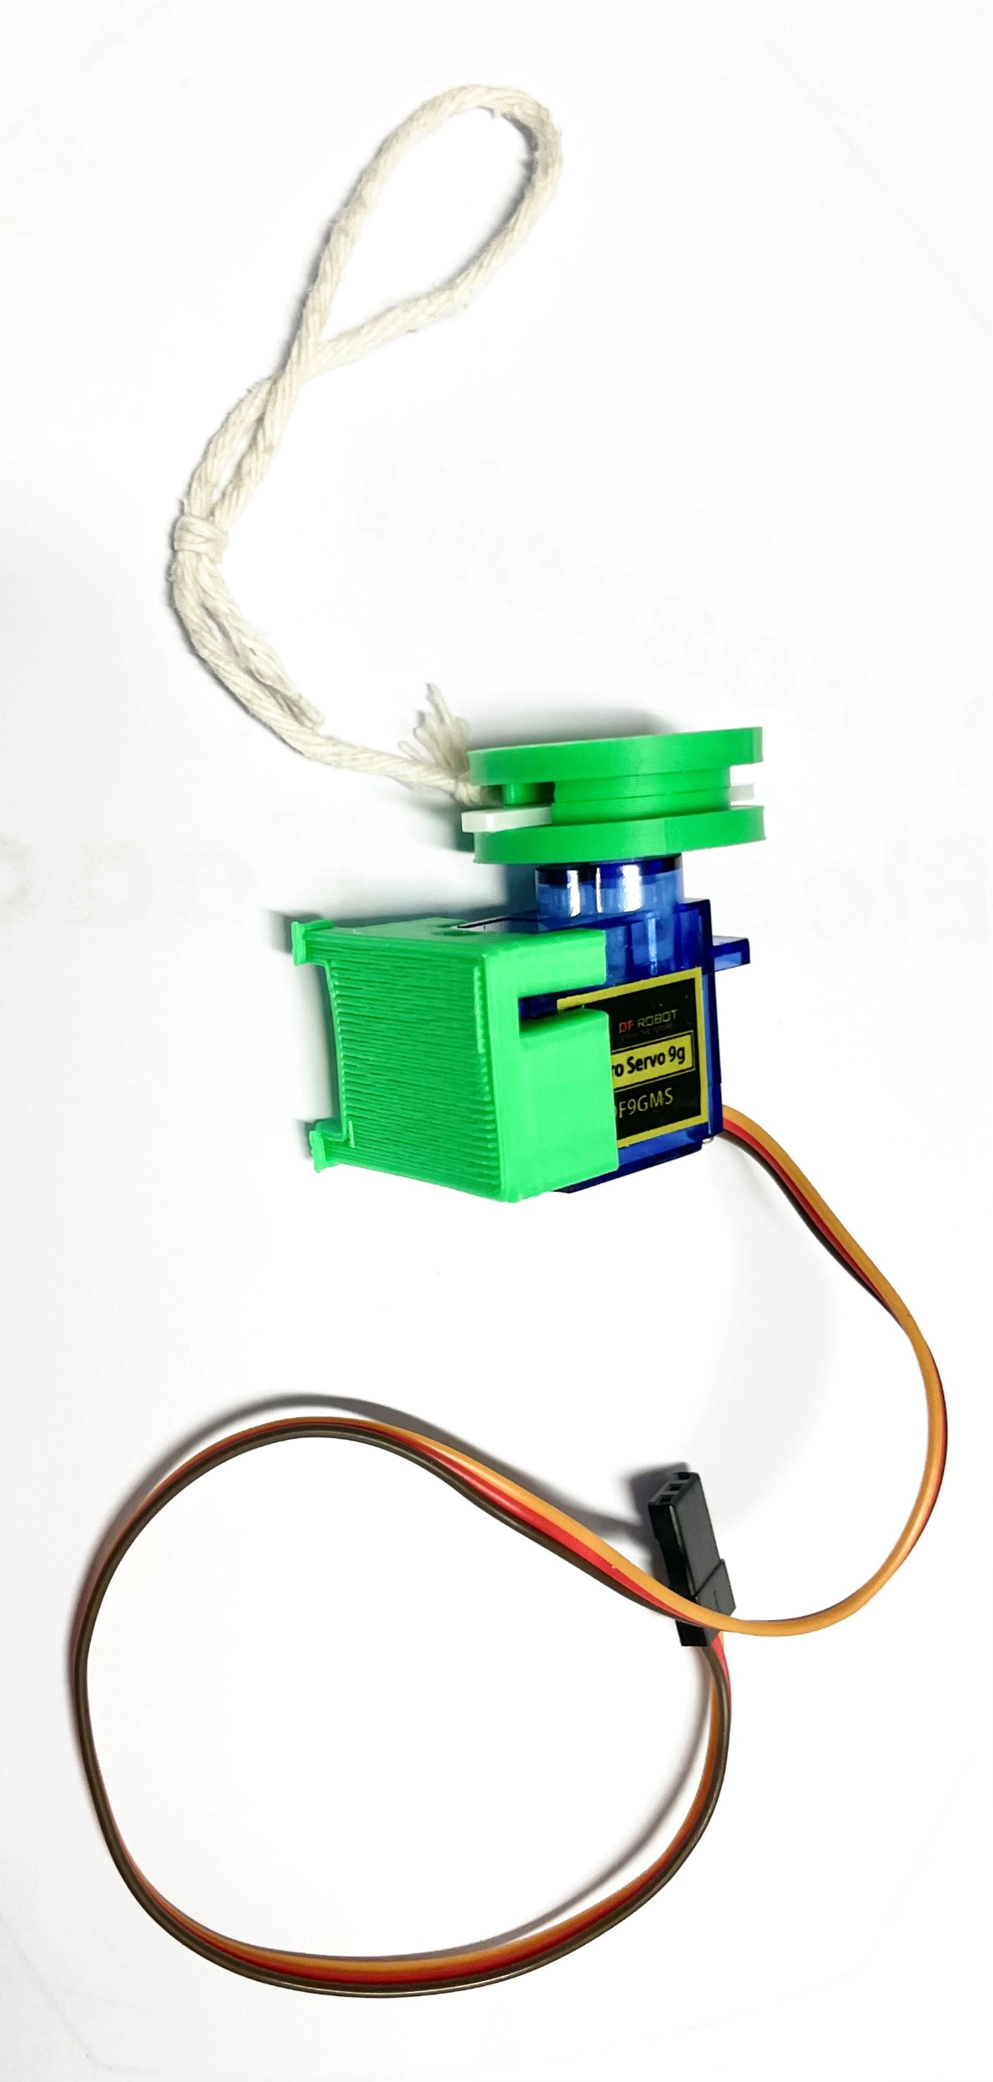
Find this piece (3x)
- SG90 tower -
What could it be for?

Slide 40
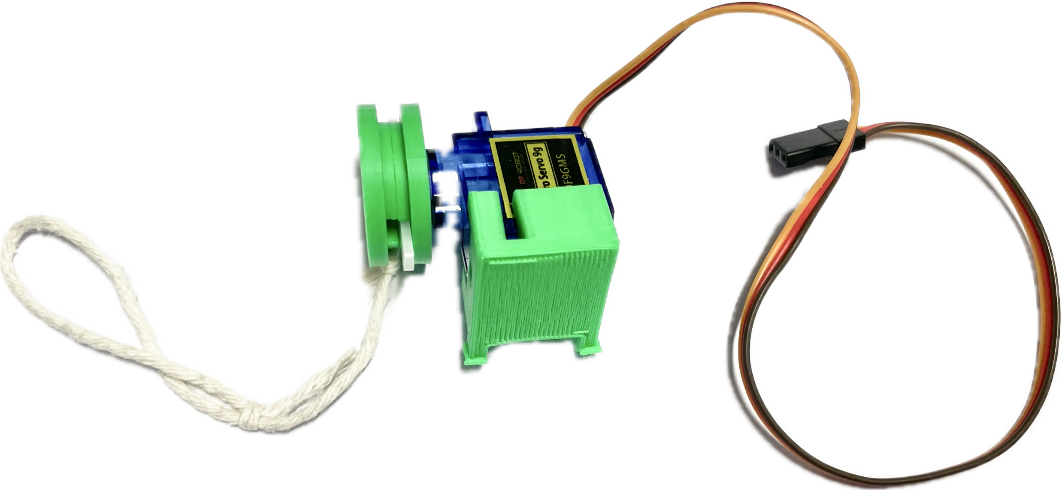
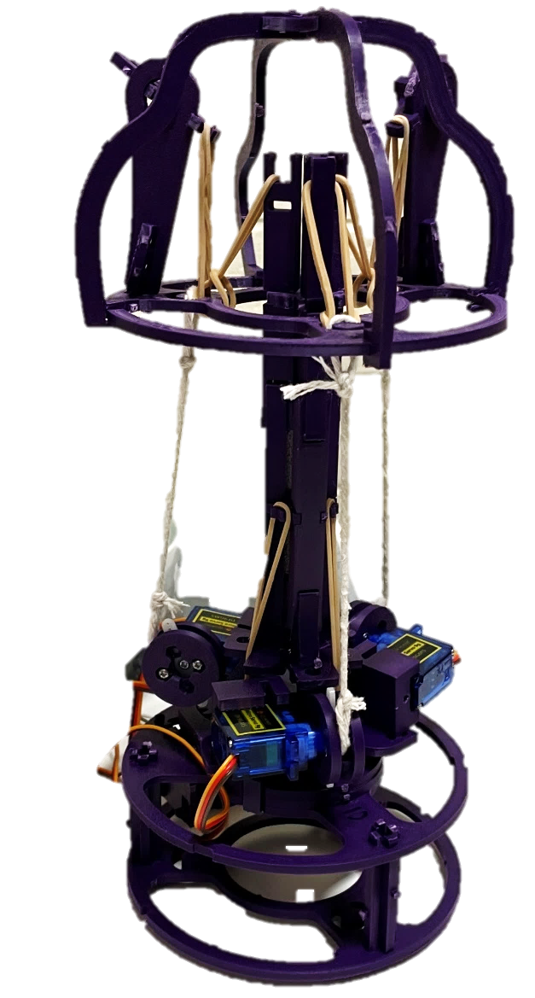
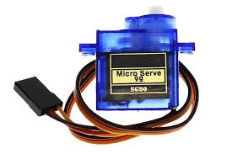
Motor
makes the robot move
How does it do that in the Blossom robot?
in the Blossom kit
in assembled robot
out of the box

Slide 41
Sensors
Instruction Note:
There will be a larger focus on sensors in lesson 2, the following slide will only give a brief overview.
Example Script:
“Sensors are the parts of machines (including robots) that tell them what is happening around them.
There are many different types of sensors that can give a robot different information about their environment.
Buttons or switches are the simplest types of sensor. A keyboard on a PC is also a sensor.”

Slide 42
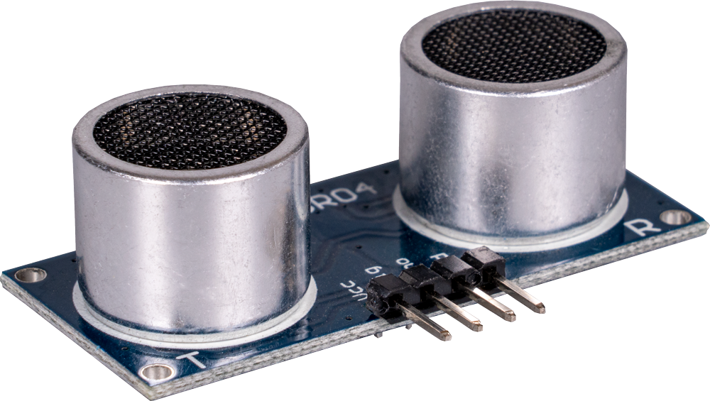
Find this piece (1x)
What could it be for?
Notes:
https://joy-it.net/files/files/Produkte/SEN-US01/SEN-US01-03.png

Slide 43
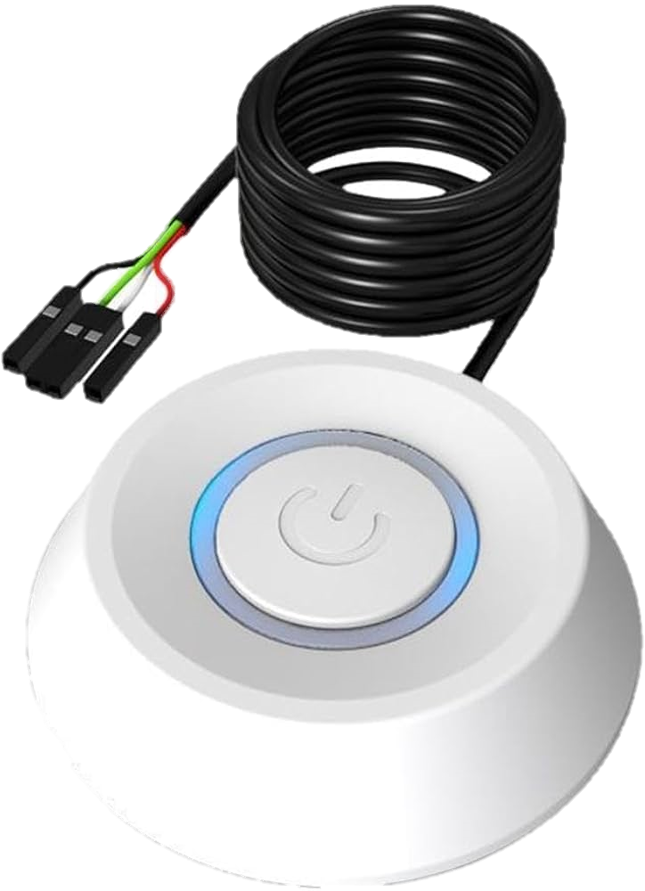

Sensors
sensors are an ‘input’ device that can tell a robot what is happening around it
buttons microphone ultrasonic sensor captures sound measures distance
Notes:
Microphone: https://media.jaycar.com.au/product/images/AM4089_pc-desktop-microphone_56712.jpg

Slide 44
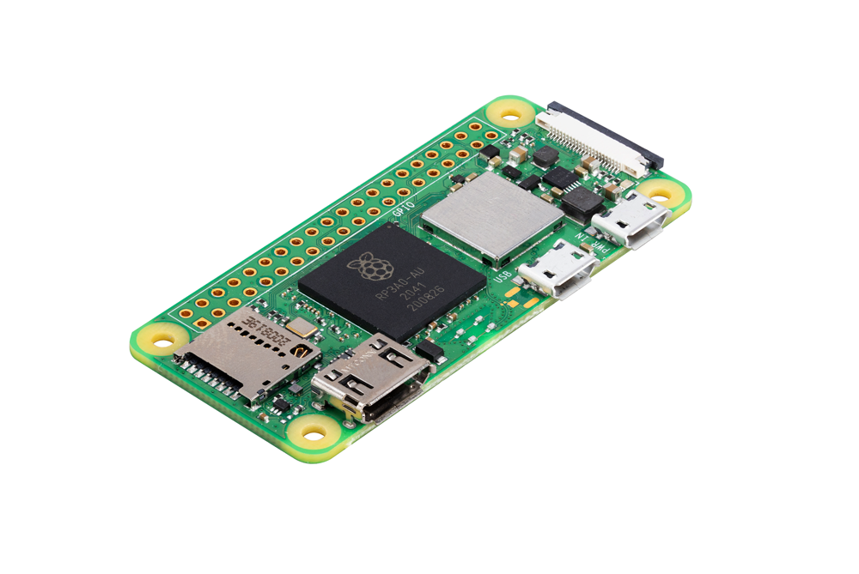
Raspberry Pi Zero 2W (Blossom’s computer)
While most computers come with a display to show user what is happening inside, some don’t (like the Raspberry Pi, but it can be connected to a monitor and be used like any other computer, e.g. browsing internet)
These so called Pi’s are simple
computers with less
computing power but are
still capable of many
tasks a standard PC
can perform.

Slide 45
Computer
Instruction Note:
Let students find the case of Blossom’s computer (the Raspberry Pi Zero) in the kit and think about what it could be for.
Tell them they can look at it, but not take anything out.

Slide 46
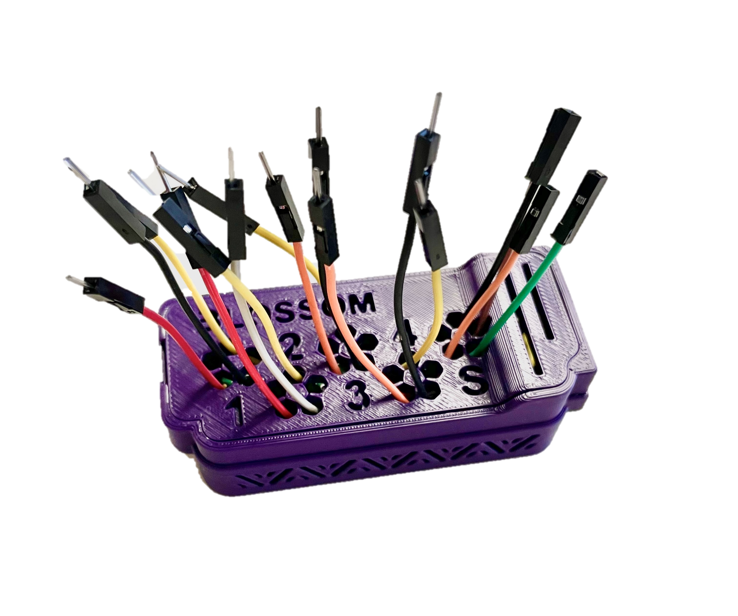
Find this piece
What could it be for?

Slide 47
Computer
Example Script:
“The computer is the control system of the robot.
It controls everything the robot does, and can be seen as its brain.
It runs code, human-written instructions telling the robot what to do.
The wires coming out of the case later connect to the motors and the sensor, getting input data and sending signals to the motor, telling it when and how to move.”
Instruction Note:
There will be a larger focus on how computers process information and how we can tell them what to do with code in the next two lessons.

Slide 48
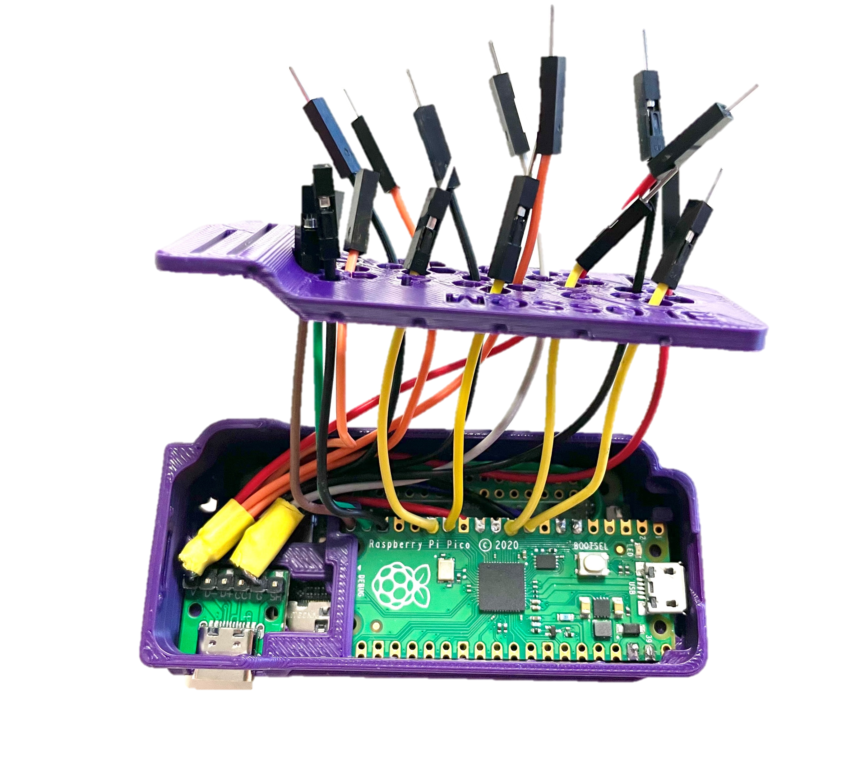
Computer
The computer is the control system of a robot.
It follows code (instructions that tell it what to do)
closed computer case

Slide 49
Computers
Example Script:
“There are many kinds of computers. What computers do you know?
  possible answers: laptops, tablets and smartphones
  all robots you’ve seen earlier are controlled by a computer
  many other machines also have a computer as a control structure inside them (e.g., digital cameras, dishwashers, washing machines, fridge, modern cars)
On the next slide you can see
  a smartphone, the inside of a smartphone,
  a raspberry pi (the computer used inside of Blossom),
  the case it is stored in when used for Blossom,
  a laptop and the inside of a laptop.
  These are all examples of what a computer can look like.”

Slide 50





Computer
The computer is the control system of a robot.
It follows code (instructions that tell it what to do)
Blossom’s computer
smartphone
laptop
Notes:
Phone: https://www.ecom-ex.com/fileadmin/_processed_/f/c/csm_smart-ex_03_classic_mode-grid_d91d783929.png

Slide 51

Wires
connect the different parts
transmit power and signals

Slide 52
Control Process
Instruction Notes:
The next slide shows in a simplified way how the different parts are connected and how environmental information is processed inside of Blossom (and many other robots and machines)
If the previous parts of the lesson have taken longer than anticipated, you can skip this slide as it will be covered in more detail in lesson 2 & 3.
Example Script:
“The sensor captures information from the environment (in this case data on the distance of the next object above the sensor)” → more detailed content on this in lesson 2
“Through wires, this information is transmitted to the raspberry pi zero 2w (the computer of Blossom). Using its software/code, it computes/decides the required response.” → more detailed content in lessons 2 and 3
“Since Blossom moves towards or away from an object in sensor mode, the response will be a movement, therefore the result of the decision-making is a new motor position. This information gets transmitted through other wires from the computer to the motors.
In response, the motors move, which makes Blossom do the programmed movement.”

Slide 53


Control Process
wire
set motor position
information from environment
wire
computer
motor
sensor
code
Blossom moves

Slide 54
Connecting to Blossom and making a motor move
The next slide contains a video & QR code for students to scan to get to the video with their own devices.
The video explain how to access Blossom’s interface, how to connect the motor to the computer through wires, and how to make it move using the interface.

Slide 55
Connecting to Blossom and making a motor move
Connect a computer to a power source
Wait for wi-fi to pop up (blossompi-XXXX)
Connect to wi-fi and go to following website
https://192.168.90.1:8080
Go to Motor calibration
Can you create movement?

Slide 56
Discussion-
When should robots be used?
Instruction Note:
Ask the students what they think when it is okay to use robots for a task?
  You can do this activity while showing the adapted “Robot Types” slide.
  This way students can consider what different robot usages have in
  common. If you don’t want to use it, feel free to hide the slide.
When might it be problematic?
  Some thoughts on this can be found on the next slide. However, there is much more that can be said.
  Further reads on ethical considerations around robot use:
  https://www.engineegroup.com/articles/TCSIT-7-156.php (general),
  https://link.springer.com/article/10.1007/s13347-019-00377-4 (workforce),
  https://www.oecd.org/content/.../Robots_and_AI-driven_robots_in_the_classroom_education.pdf (education)
Notes:
Further reads:

Slide 57
Discussion-
When should robots be used?
Can be useful:
  dangerous: for tasks or in places that could harm people (e.g. space exploration, search and rescue)
  dull: long and repetitive tasks that humans might not want to do (e.g. domestic or industrial robots)
  precise: for delicate tasks that are too difficult with our hands (e.g. medical, industrial)
  labour shortage: tasks not enough humans are available for or willing to do
Can be problematic:
  replacing humans: job displacement & unemployment, isolation (e.g. if overreliance on robots in aged care), loss of human skilled labour
  befriending humans: emotional dependency, illusion of caring but don’t really understand what humans are saying (more in following lessons), can lead to social isolation, inappropriate responses to humans
  inequitable access: robots often expensive, can require high technical knowledge to use
  deliberate misuse: robots can be programmed to do harmful things
Notes:
Further reads:

Slide 58
When should robots (not) be used?
Discovery robots
Industrial robots
Domestic robots
Entertainment robots
Educational robots
Medical robots
Notes:
BMW: https://themanufacturer-cdn-1.s3.eu-west-2.amazonaws.com/wp-content/uploads/2013/10/14115325/BD_spotwelding_S0568_054-1024x713.jpg
Drone: https://static.vecteezy.com/system/resources/thumbnails/006/024/471/small/delivery-drone-in-warehouse-photo.jpg
Medical: https://www.sportssurgeryclinic.com/wp-content/uploads/2025/01/EXCL_1609_TECH_FINALCONSTRUCT_EXCELSIUS_GPS_US_Robotics_System_FINALCONSTRUCT_OR_Setup-660x602.png.webp
Dog: https://d1fwgdbfuvd4ew.cloudfront.net/wp-content/uploads/sites/2/2022/11/03_1-thumb-765xauto-295.jpg
Football: https://c.files.bbci.co.uk/5CA5/production/_120671732_rcthu-64lr.jpg
Search and rescue: https://bostondynamics.com/wp-content/uploads/2023/11/spot-rubble-1024x538.jpg
Space: https://www.robotics247.com/images/article/GettyImages-1006754478_copy.jpg

Slide 59
Survey
Lastly, let students answer the questionnaire for lesson 1.
Tell them beforehand:
  “At the end of each lesson, you will all be asked to complete a short survey. The questions asked will be the same after each lesson.”
  “This is not a test. There are no right or wrong answers when you’re sharing your thoughts.
    Your feedback will be used to help improve the lessons in the future.
    It is important to answer honestly and to be as clear as possible.”
  “Try to respond to each question, but you can leave questions blank if you don’t want to answer.
  Don’t share any personal information in your responses.”

Slide 60

Survey

Slide 61
Summary
Go over the main points of the lesson again to help students consolidate their learning. You can let them talk with a partner first, then let one or two students answer to the whole class. There will always be a lesson recap at the beginning of the next lesson. If you are out of time after the survey, you can skip the summary.
“We learned today that there are many different types of robots and various tasks that robots are used for. Talk to the person next to you and see how many you can remember.”
  Then ask the class to mention (at least) 3 different types/applications.
“We also saw that it’s not always easy to tell robots from other types of machines, but there are some key features that most robots have in common. Discuss with the person next to you what makes a robot a robot.
  let students repeat the key features of robots (machines that use sensors to receive information from their environment, can move in the real world and are intelligent, i.e. can make decisions from the sensor input and the software/code to choose the next action)
Some robots are social robots, repeat what that means (this is not a key learning objective and therefore not on the summary slide).
  Social robots are those that have can have social and emotional communication abilities

Slide 62
Summary
Ask students to repeat the most important parts of a robot and what they are for.
  sensors (get information from environment), motor (creates movement), computer + software (controls what the robot does), wires (connect everything), power source (provides electrical energy that the pieces need to function), mechanical structure (holds everything together and gives the robot its shape)
Go over the simple control process from Blossom’s sensor input to movement. (Skip if out of time, as this will be in the next lesson as well)
  sensor captures information from the environment, transmits info through wires to computer, uses code to compute what to do, sends information through wire to motor to tell it what position to change to, motor moves → Blossom moves
Let students repeat 2 helpful and 2 harmful uses of robots.
  can be helpful: tasks are dangerous, dull, require high precision, labour shortage
  can be harmful: replacing humans, befriending humans, inequitable access, deliberate misuse

Slide 63
Summary –
Introduction to Robots
Robots come in many shapes. Name 3 types of robots.
What makes a robot a robot?
  machine that senses + moves in the real world + is intelligent (uses code to choose an action)
Main robot parts
  sensor (notice), motor (move), computer (control), wires (connect), power supply (energy), mechanical structure (holds together)
Control Process from sensor input to movement:
  sensor input → wire → computer with code → wire → motor
Robots can be both helpful and harmful depending on the context. Name 2 examples for each.

